Slide 1
程式語言實習(二)
第五週(03/22 ~ 03/28)

Slide 2
程式撰寫步驟
產生畫面，看得到按鈕
建立基本功能，讓按鈕點擊後可以顯示文字
建立主要功能，判斷玩家是否獲勝

Slide 3
建立視窗
from tkinter import * def main(): root = Tk() root.title("標題名稱") root.mainloop() main()

Slide 4

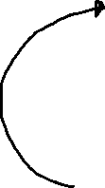
新增標籤
#... v = 0 def main(): #... global v v = StringVar() v.set("輪到 " + str(name[r])) topFrame = Frame(root, width=300, height=100) topFrame.pack_propagate(False) topFrame.grid(row=0, column=0, columnspan=3) Label(topFrame, textvariable=v).pack(expand=True, fill=BOTH) #...
Label
.pack_propagate(False) 是為了讓框架(Frame)可以設定固定大小，否則它只會包覆框架內的物件。
.pack(expand=True, fill=BOTH) 將水平及垂直空間填滿並將剩餘空間分配給物件。

Slide 5
新增按鈕
#... array = [[0 for i in range(3)] for j in range(3)] def main(): #... for y in range(3): for x in range(3): btnFrame = Frame(root, width=100, height=100) btnFrame.pack_propagate(False) btnFrame.grid(row=y+1, column=x) array[y][x] = Button(btnFrame, text="") array[y][x].pack(expand=True, fill=BOTH) #...
Label
button | Button | Button
button | button | Button
button | button | button

Slide 6
第一步驟完成
from tkinter import * v = 0 array = [[0 for i in range(3)] for j in range(3)] def main(): root = Tk() root.title("標題名稱") global v v = StringVar() v.set("輪到 " + str(name[r])) topFrame = Frame(root, width=300, height=100) topFrame.pack_propagate(False) topFrame.grid(row=0, column=0, columnspan=3) Label(topFrame, textvariable=v).pack(expand=True, fill=BOTH) for y in range(3): for x in range(3): btnFrame = Frame(root, width=100, height=100) btnFrame.pack_propagate(False) btnFrame.grid(row=y+1, column=x) array[y][x] = Button(btnFrame, text="") array[y][x].pack(expand=True, fill=BOTH) root.mainloop() main()
Label
button | Button | Button
button | button | Button
button | button | button

Slide 7
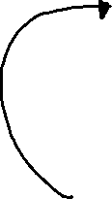
建立基本功能
name = ["player1", "player2"] player = ["O", "X"] status = "playing" r = 0 count = 0 def play(x, y): global r, status, count if array[y][x]['text'] == "" and status == "playing": array[y][x].config(text=player[r]) count += 1 if r == 0: r = 1 else: r = 0 v.set("輪到 " + str(name[r]))
只有在按鈕未被點擊過且遊戲尚未結束才執行

Slide 8
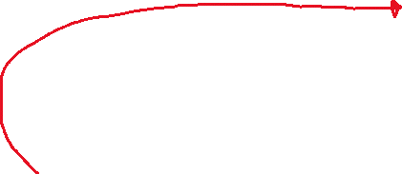
建立基本功能
def main(): #... for y in range(3): for x in range(3): btnFrame = Frame(root, width=100, height=100) btnFrame.pack_propagate(False) btnFrame.grid(row=y+1, column=x) array[y][x] = Button(btnFrame, text="", command= lambda tmpX=x, tmpY=y : play(tmpX, tmpY)) array[y][x].pack(expand=True, fill=BOTH) #...
將 play 函式完成後，新增到按鈕上

Slide 9
第二步驟完成
from tkinter import * v = 0 array = [[0 for i in range(3)] for j in range(3)] def main(): root = Tk() root.title(“標題名稱") global v v = StringVar() v.set("輪到 " + str(name[r])) topFrame = Frame(root, width=300, height=100) topFrame.pack_propagate(False) topFrame.grid(row=0, column=0, columnspan=3) Label(topFrame, textvariable=v).pack(expand=True, fill=BOTH) for y in range(3): for x in range(3): btnFrame = Frame(root, width=100, height=100) btnFrame.pack_propagate(False) btnFrame.grid(row=y+1, column=x) array[y][x] = Button(btnFrame, text="", command= lambda tmpX=x, tmpY=y : play(tmpX, tmpY)) array[y][x].pack(expand=True, fill=BOTH) root.mainloop()
name = ["player1", "player2"] player = ["O", "X"] status = "playing" r = 0 count = 0 def play(x, y): global r, status, count if array[y][x]['text'] == "" and status == "playing": array[y][x].config(text=player[r]) count += 1 if r == 0: r = 1 else: r = 0 v.set("輪到 " + str(name[r])) main()

Slide 10


判斷是否獲勝(直排、橫排)
def getStatus(x, y): if array[y][x]['text'] == array[y][(x+1) % 3]['text'] == array[y][(x+2) % 3]['text']: return "WIN" if array[y][x]['text'] == array[(y+1) % 3][x]['text'] == array[(y+2) % 3][x]['text']: return "WIN"
Button | Button | Button
Button | Button | Button
Button | Button | Button
Button | Button | Button
Button | Button | Button
Button | Button | Button
上面判斷式是Python寫法，與 A == B and B == C and C == A 意思相同。

Slide 11
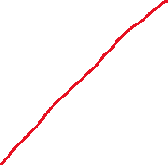
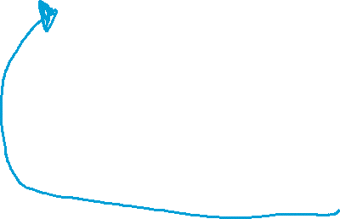

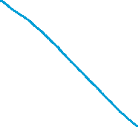

判斷是否獲勝(斜線)
def getStatus(x, y): #... if (x == 0 and y == 0) or (x == 2 and y == 2) or (x == 1 and y == 1): if array[y][x]['text'] == array[(y+1) % 3][(x+1) % 3]['text'] == array[(y+2) % 3][(x+2) % 3]['text']: return "WIN" if (x == 2 and y == 0) or (x == 1 and y == 1) or (x == 0 and y == 2): if array[y][x]['text'] == array[(y+1) % 3][(x+2) % 3]['text'] == array[y][x]['text']: return "WIN" if count == 9: return "Tie" return "playing"
Button | Button | Button
Button | Button | Button
Button | Button | Button
Button | Button | Button
Button | Button | Button
Button | Button | Button
當 count 為 9 表示平手

Slide 12
成功按下按鈕後判斷是否結束遊戲
def play(x, y): global r, status, count if array[y][x]['text'] == "" and status == "playing": array[y][x].config(text=player[r]) count += 1 status = getStatus(x, y) if status == "WIN": v.set(str(name[r]) + " 獲勝") elif status == "Tie": v.set("平手") else: if r == 0: r = 1 else: r = 0 v.set("輪到 " + str(name[r])) #...

Slide 13
第三步驟完成
from tkinter import * v = 0 array = [[0 for i in range(3)] for j in range(3)] def main(): root = Tk() root.title("標題名稱") global v v = StringVar() v.set("輪到 " + str(name[r])) topFrame = Frame(root, width=300, height=100) topFrame.pack_propagate(False) topFrame.grid(row=0, column=0, columnspan=3) Label(topFrame, textvariable=v).pack(expand=True, fill=BOTH) for y in range(3): for x in range(3): btnFrame = Frame(root, width=100, height=100) btnFrame.pack_propagate(False) btnFrame.grid(row=y+1, column=x) array[y][x] = Button(btnFrame, text="", command= lambda tmpX=x, tmpY=y : play(tmpX, tmpY)) array[y][x].pack(expand=True, fill=BOTH) root.mainloop() name = ["player1", "player2"] player = ["O", "X"] status = "playing" r = 0 count = 0
def play(x, y): global r, status, count if array[y][x]['text'] == "" and status == "playing": array[y][x].config(text=player[r]) count += 1 status = getStatus(x, y) if status == "WIN": v.set(str(name[r]) + " 獲勝") elif status == "Tie": v.set("平手") else: if r == 0: r = 1 else: r = 0 v.set("輪到 " + str(name[r])) def getStatus(x, y): if array[y][x]['text'] == array[y][(x+1) % 3]['text'] == array[y][(x+2) % 3]['text']: return "WIN" if array[y][x]['text'] == array[(y+1) % 3][x]['text'] == array[(y+2) % 3][x]['text']: return "WIN" if (x == 0 and y == 0) or (x == 2 and y == 2) or (x == 1 and y == 1): if array[y][x]['text'] == array[(y+1) % 3][(x+1) % 3]['text'] == array[(y+2) % 3][(x+2) % 3]['text']: return "WIN" if (x == 2 and y == 0) or (x == 1 and y == 1) or (x == 0 and y == 2): if array[y][x]['text'] == array[(y+1) % 3][(x+2) % 3]['text'] == array[y][x]['text']: return "WIN" if count == 9: return "Tie" return "playing" main()

